Slide 1

Data Wrangling and Visualization in Tableau

Slide 2
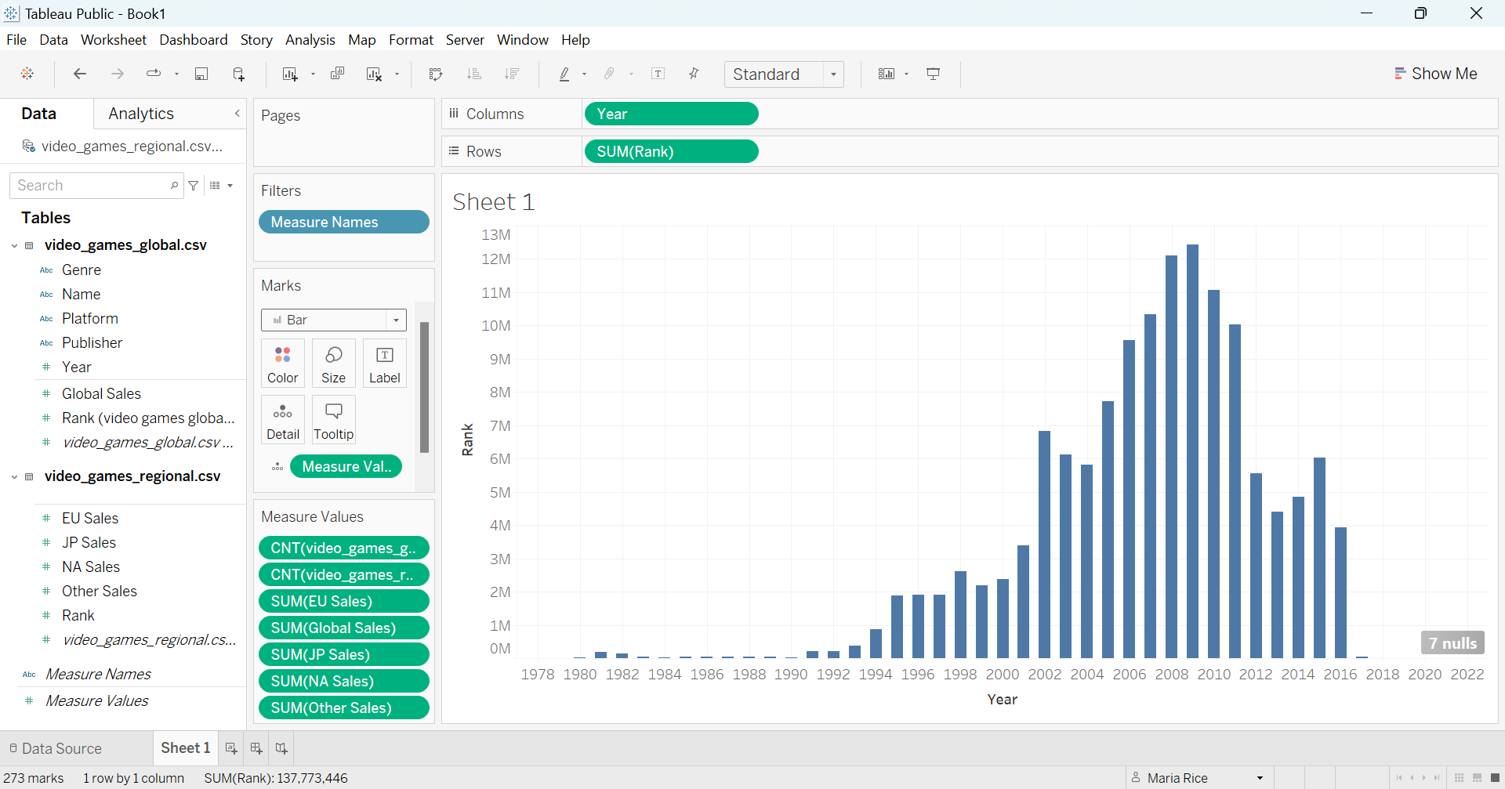
Video games sales started out very small in the 1900s but did start to increase more in 1994. In the year 2002 sales were going up. It slightly decreased in the next two years following but the sales started climbing again in 2005. The years of 2008 and 2009 is when sales were at their peak. I am very surprised to discover that it shows decreasing after that because now more than ever video games are very popular. How is it possible for sales to go down to almost nothing by 2017 when many children, teens and adults have access to even more of them?

Slide 3
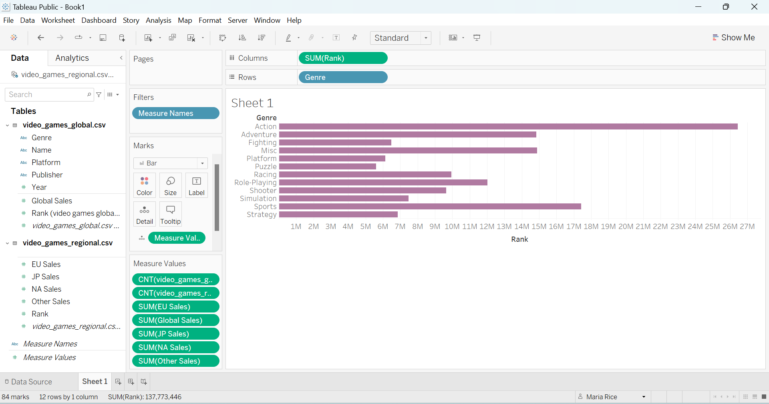
The most popular genre of video games is Action (not surprising!). Sports comes in second and adventure and misc. come in as a tie for third.

Slide 4
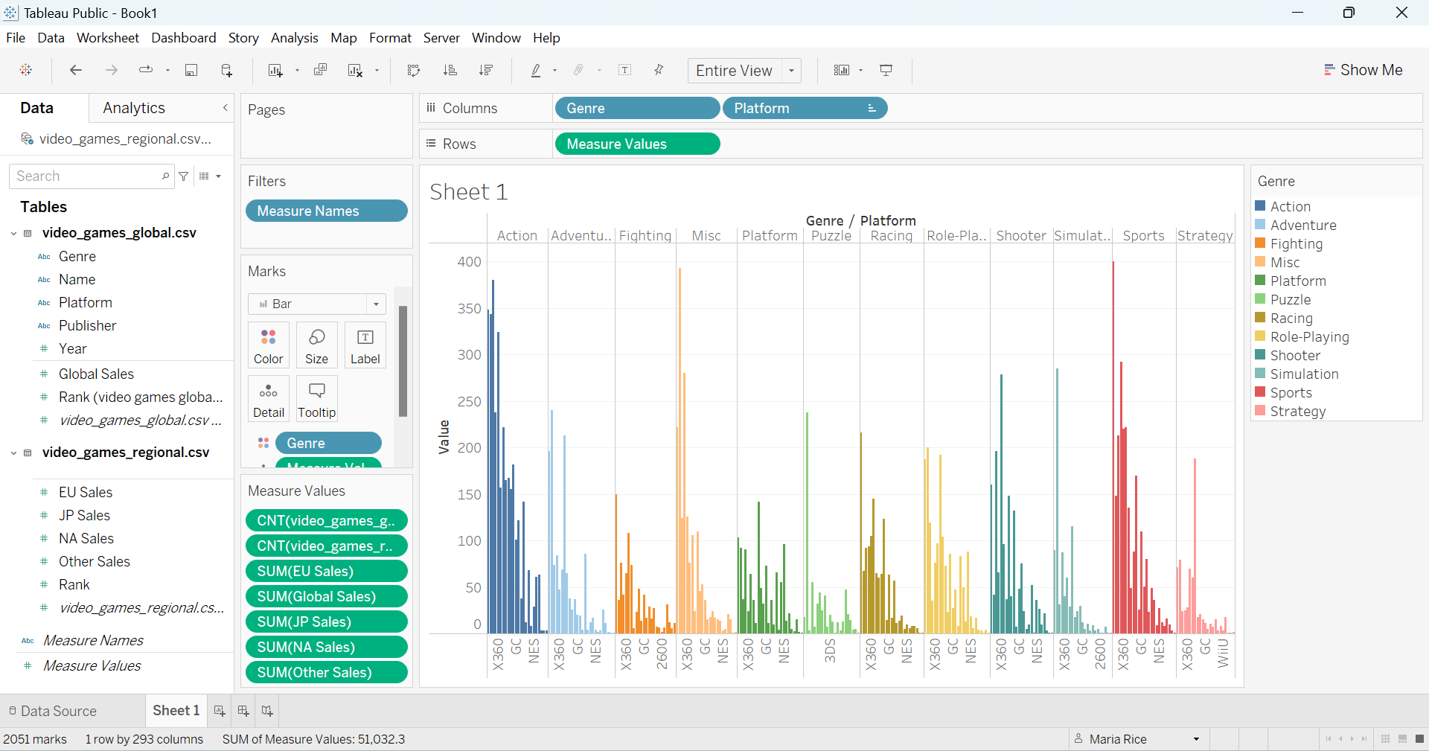
Below is a comparison of video game platforms by genre. As the bar graph shows, x360 is the most popular platforming most genres. In the genre “strategy” GC is higher than x360 and WiIU. It also appears to be higher in for Gc in the genre” platform”. I’m not sure I have this graph right because there are bars in between the platform labels instead of one line directly above them.

Slide 5
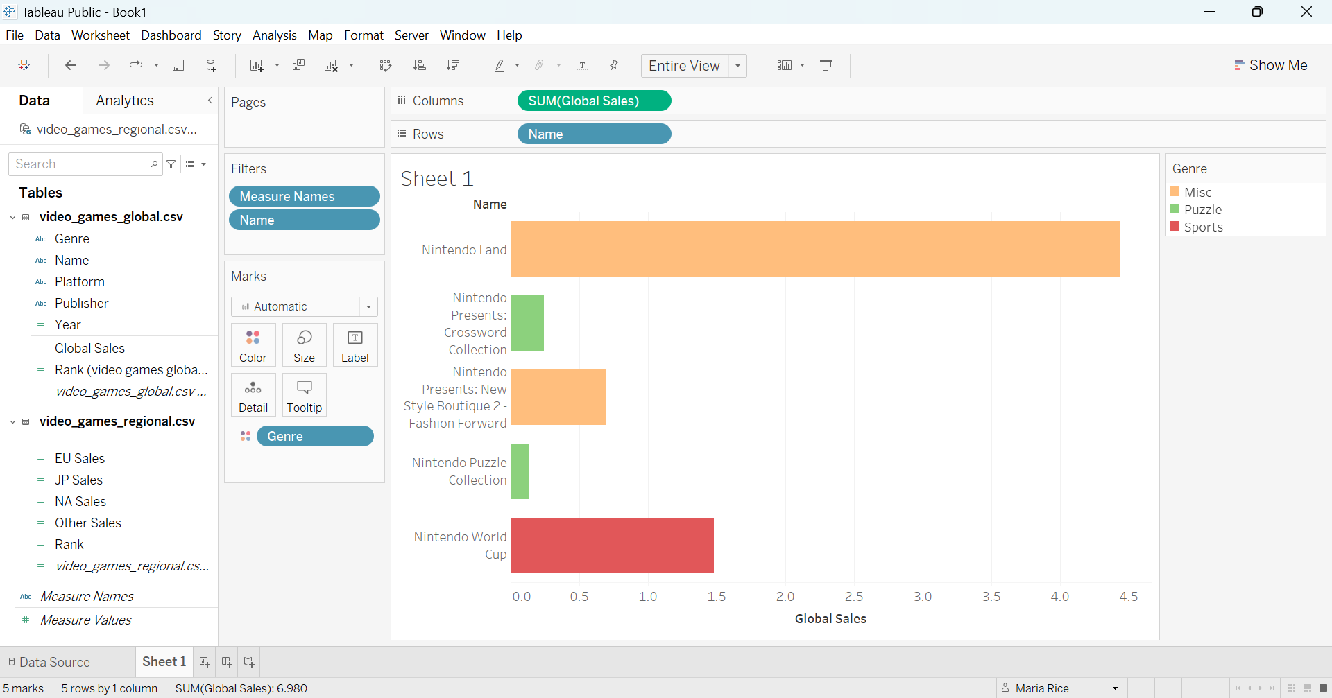
Below is a graph looking at only Nintendo Games. Nintendo Land Is the most sold video gam. It is two and a half more times popular than Nintendo World Cup and is four times more popular than New Style Boutique 2.

